Slide 1
MScAE & MScDABE
Bridging Course
Statistics
By Cao, Kang Hua （曹康华）

Slide 2
Exploratory Data Analysis

Slide 3
Population and Sample
Population: The total set of subjects in which we are
interested
Sample: Subset of the population for whom we have data
Population
Sample

Slide 4
Example: An Exit Poll
The purpose was to predict the outcome of the 2010 state election in California.
An exit poll sampled 3889 of the 9.5 million people who voted. Define the sample and the population for this exit poll.
  The population was the 9.5 million people who voted in the election.
  The sample was the 3889 voters who were interviewed in the exit poll.

Slide 5
We Observe Samples but are Interested in Populations
Subjects
  The entities that we measure in a study
  Subjects could be individuals, schools, countries, or days.

Slide 6
Data and Examples of Collecting Data
The information we gather with experiments and surveys is collectively called data.
Example: Experiment on low carbohydrate diet
  Data could be measurements on subjects before and after the experiment.
Example: Survey on effectiveness of a TV ad
  Data could be percentage of people who went to Starbucks since the ad aired.

Slide 7
Define Statistics
Statistics is the art and science of:
  Designing studies
  Analyzing the data produced by these studies
  Translating data into knowledge and understanding of the world around us

Slide 8
Reasons for Using Statistical Methods
The three main components of statistics for answering a statistical question:
Design: Planning how to obtain data
Description: Summarizing the data obtained
Inference: Making decisions and predictions

Slide 9
Design
Design questions:
  How to conduct the experiment, or
  How to select people for the survey to ensure trustworthy results
Examples:
  Planning the methods for data collection to study the effects of Vitamin C
  For a marketing study, how do you select people for your survey so you’ll get data that provide accurate predictions about future sales?

Slide 10
Description
Description:
  Summarize the raw data and present it in a useful format (e.g., average, charts or graphs).
Examples:
  It is more informative to use a few numbers or a graph to summarize the data, such as an average amount of TV watched, or
  A graph displaying how number of hours of TV watched per day relates to number of hours per week exercising.

Slide 11
Inference
Inference: Make decisions or predictions based on the data.
Examples:
  Has there been global warming over the past decade?
  Is having the death penalty as a possible punishment associated with a reduction in violent crime?
  Does student performance in school depend on the amount of money spent per student, the size of the classes, or the teachers’ salaries?

Slide 12
Probability
Probability: A framework for quantifying how likely various possible outcomes are.
Example:
If Brown were actually going to lose the election (that is, if he were supported by less than half of all voters), what’s the chance that an exit poll of 3889 voters would show support by 53.1% of the voters?

Slide 13
Descriptive Statistics and Inferential Statistics
Descriptive Statistics refers to methods for summarizing the collected data. Summaries consist of graphs and numbers such as averages and percentages.
Inferential statistics refers to methods of making decisions or predictions about a population based on data obtained from a sample of that population.

Slide 14
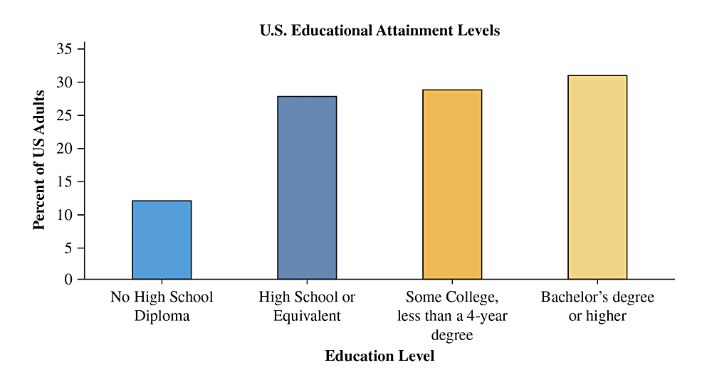
Descriptive Statistics Example
Figure 1.1 Educational Attainment, Based on a Sample of 78,000 Households in the 2013 Current Population Survey.

Slide 15
Inferential Statistics Example
Suppose we’d like to know what people think about controls over the sales of handguns. We can study results from a recent poll of 834 Florida residents.
In that poll, 54.0% of the sampled subjects said they
favored controls over the sales of handguns.
We are 95% confident that the percentage of all adult
Floridians favoring control over sales of handguns falls
between 49.6% and 57.4%.

Slide 16
Sample Statistics and Population Parameters
A parameter is a numerical summary of the population.
Example: Percentage of the population of all Florida residents favoring handgun control
A statistic is a numerical summary of a sample taken from the population.
Example: 54.0% of the sampled subjects said they
favored controls over the sales of handguns.

Slide 17
Randomness and Variability
Random sampling allows us to make powerful inferences about populations.
Randomness is also crucial to performing experiments well.

Slide 18
Randomness and Variability
Measurements may vary from person to person, and just as people vary, so do samples vary. Measurements may vary from sample to sample.
Predictions will, therefore, be more accurate for larger samples.

Slide 19
Estimation from Surveys with Random Sampling
Data from sample surveys are frequently used to estimate population percentages.
Example: A Gallup poll recently reported that 30% of Americans worried that they might not be able to pay health insurance costs during the next 12 months.

Slide 20
Estimation from Surveys with Random Sampling
Margin of error is a measure of the expected variability from one random sample to the next random sample.
Example: A margin of error of plus or minus 3 percentage points means it is very likely that the population percentage is no more than 3% lower or 3% higher than the reported sample percentage.

Slide 21
Testing and Statistical Significance
When the difference between the results for two treatments is so large that it would be rare to see such a difference by ordinary random variation, we say that the results are statistically significant.

Slide 22
Measuring the Center of Quantitative Data

Slide 23
Mean
The mean is the sum of the observations divided by the number of observations.

Slide 24
Example: Center of the Cereal Sodium Data
We find the mean by adding all the observations and then dividing this sum by the number of observations, which is 20:
0, 340, 140,70, 200, 180, 210, 150, 100, 130,
140, 180, 190, 160, 290, 50, 220, 180, 200, 210
Mean = (0 + 340 + 70 + . . . +210)/20 = 3340/20 =167

Slide 25
Median
The median is the middle value of the observations when they are ordered from the smallest to the largest (or from the largest to smallest).
How to Determine the Median:
1 3 2 6 9 -> 1 2 3 6 9 -> median = 3
1 3 2 6 -> 1 2 3 6 -> median = (2 + 3)/2 = 2.5
Put the n observations in order of their size.
If the number of observations, n, is:
  odd, then the median is the middle observation. 5 obs, median is the 3rd, 7 -> 5th is the median
  even, then the median is the average of the two middle observations. 6 obs -> 3rd and 4th

Slide 26
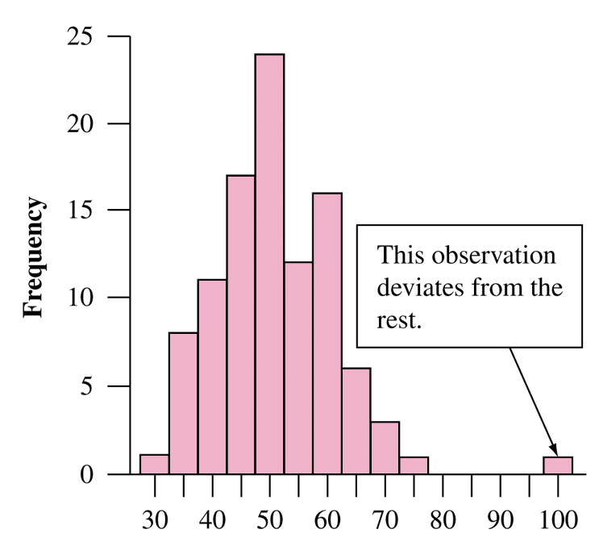
Outlier
An outlier is an observation that falls well above or well below the overall bulk of the data.

Slide 27
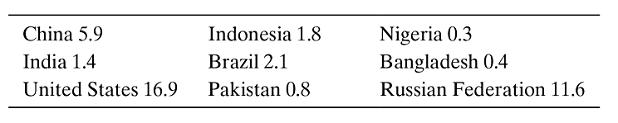
Example: CO₂ Pollution
CO₂ pollution levels in 9 largest nations measured in metric tons per person:
The CO₂ values have n = 9 observations. The ordered values are: 0.3, 0.4, 0.8, 1.4, 1.8, 2.1, 5.9, 11.6, 16.9.

Slide 28
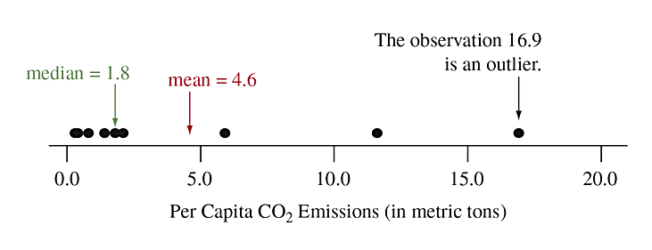
Example: CO₂ Pollution
Since n is odd, the median is the middle value, 1.8.
The relatively high value of 16.9 falls well above the rest of the
data. It is an outlier.
The size of the outlier affects the calculation of the mean but not
the median.

Slide 29
Comparing the Mean and Median
The shape of a distribution influences whether the mean is larger or smaller than the median.
Perfectly symmetric, the mean equals the median.
Skewed to the left, the mean is smaller than the
median.
Skewed to the right, the mean is larger than the
median.

Slide 30
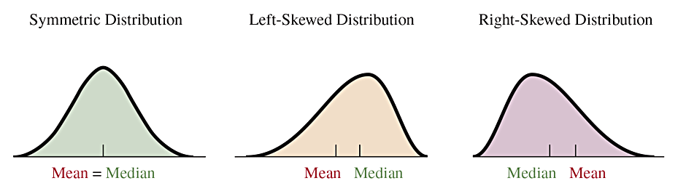
Comparing the Mean and Median
In a skewed distribution, the mean is farther out in the long tail than is the median.
  For skewed distributions the median is preferred because it better represents what is typical.
Figure 2.9 Relationship Between the Mean and Median. Question: For skewed distributions, what causes the mean and median to differ?

Slide 31
Resistant Measures
A numerical summary measure is resistant if extreme observations (outliers) have little, if any, influence on its value.
  The Median is resistant to outliers.
  The Mean is not resistant to outliers.

Slide 32
The Mode
Mode
  Value that occurs most often.
  Highest bar in the histogram.
  The mode is most often used with categorical data.
  1 1 2 1 3 1 1 5; 1 1 1 1 1 2 3 5
  mode = 1 and median = 1

Slide 33
Measuring the Variability of Quantitative Data

Slide 34
Range
One way to measure the variability of a distribution is to calculate the range.
The range is the difference between the largest and smallest values in the data set:
Range = maximum value – minimum value
The range is simple to compute and easy to understand, but it uses only the extreme values and ignores the other values. Therefore, it’s affected severely by outliers.

Slide 35
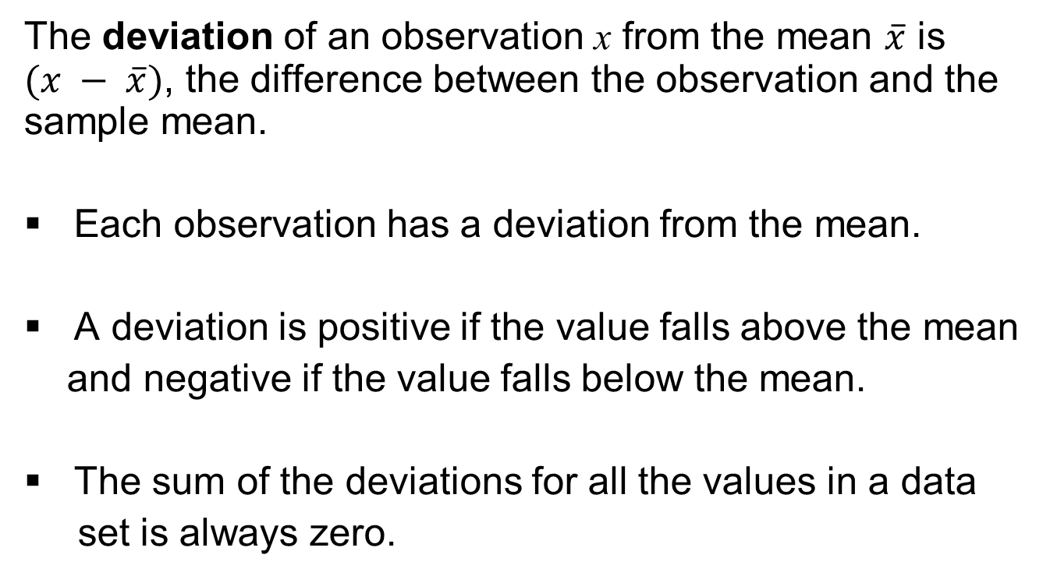
Standard Deviation
1 1 1 1 1 2 3 5

Slide 36
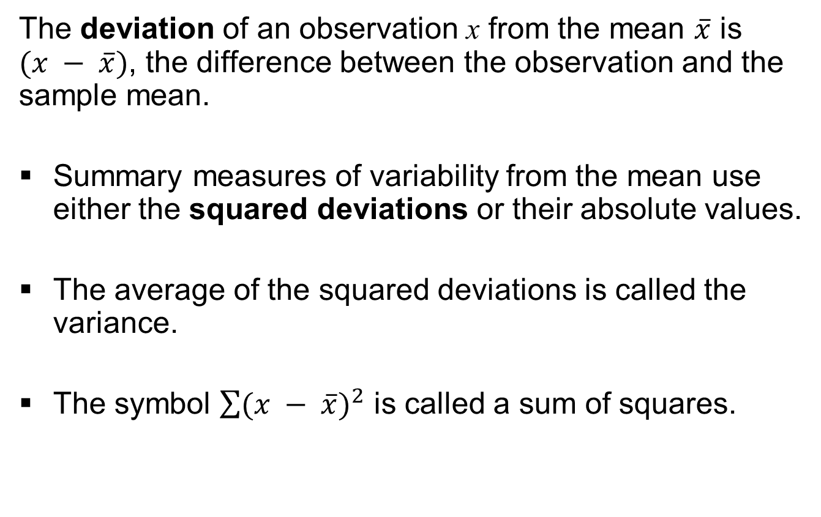
Standard Deviation

Slide 37
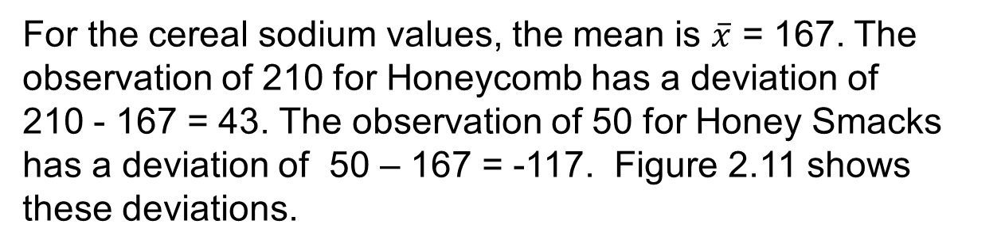
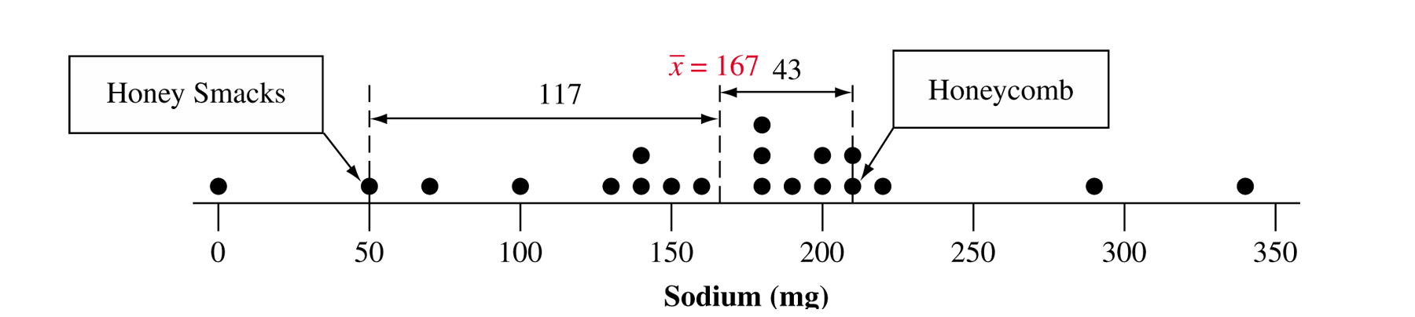
Standard Deviation Example
Figure 2.11 Dot Plot for Cereal Sodium Data, Showing Deviations for Two Observations. Question: When is a deviation positive and when is it negative?

Slide 38
The Standard Deviation s of n Observations
Gives a measure of variation by summarizing the deviations of each observation from the mean and calculating an adjusted average of these deviations.
The larger the standard deviation, s, the greater the variability of the data.
Notes:
Why dividing by n-1: https://stats.stackexchange.com/questions/3931/intuitive-explanation-for-dividing-by-n-1-when-calculating-standard-deviation

Slide 39
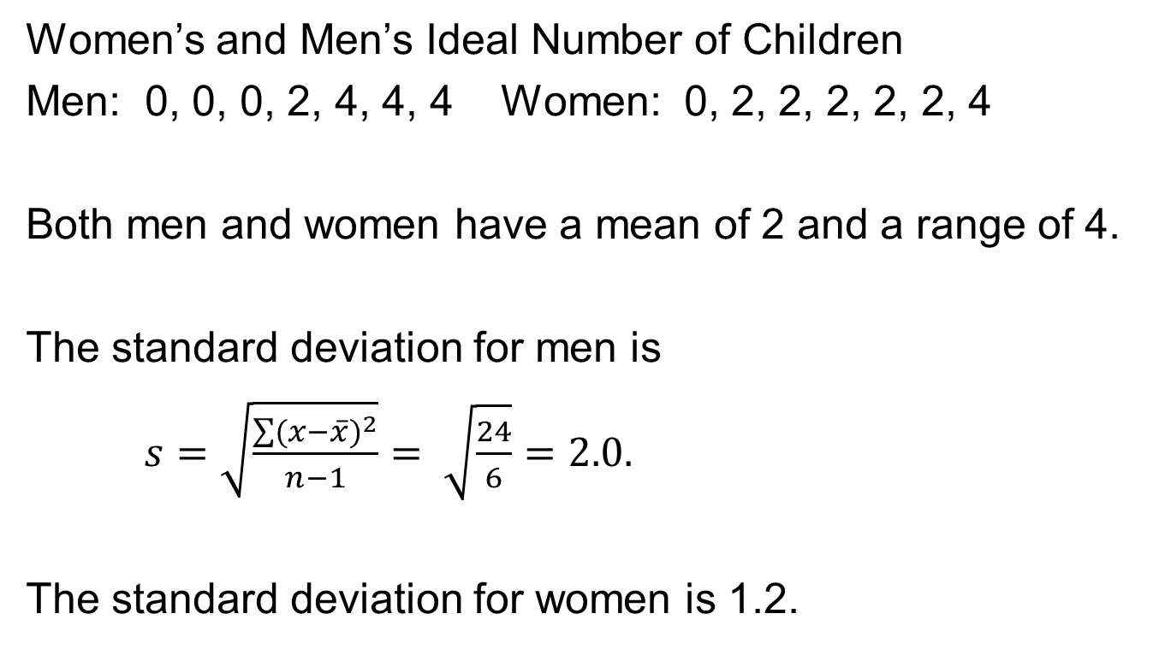
Standard Deviation Example

Slide 40
Properties of the Standard Deviation
The most basic property of the standard deviation is this:
The larger the standard deviation S, the greater the variability of the data.
S measures the spread of the data.
S = 0 only when all observations have the same value, otherwise S > 0. As the spread of the data increases, S gets larger.
S has the same units of measurement as the original
observations. The variance = S ² has units that are squared.
S is not resistant. Strong skewness or a few outliers can greatly
increase S.

Slide 41
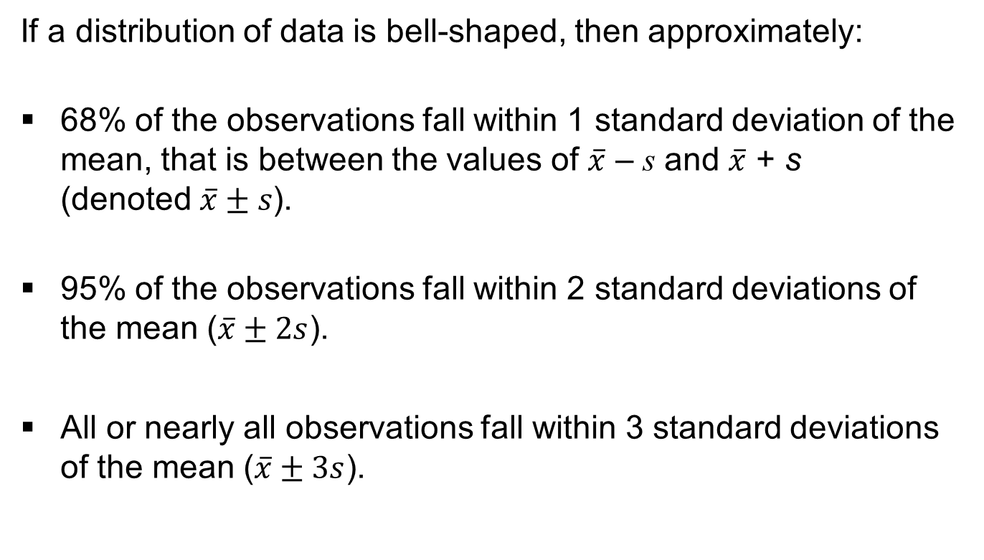
Magnitude of s: The Empirical Rule

Slide 42
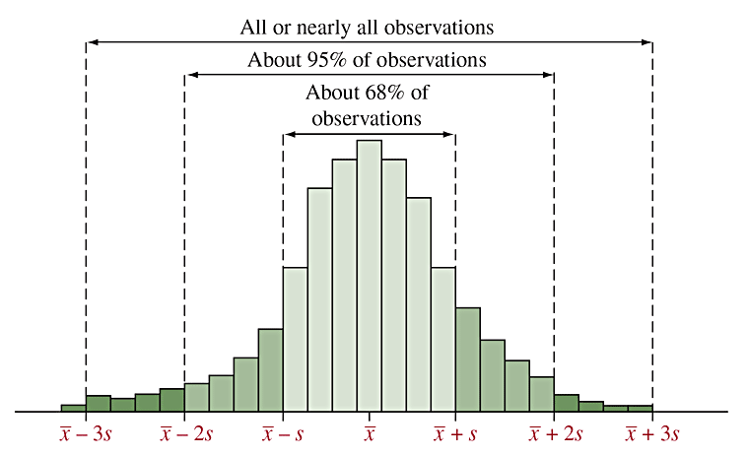
Magnitude of s: The Empirical Rule
Figure 2.12 The Empirical Rule. For bell-shaped distributions, this tells us approximately how much of the data fall within 1, 2, and 3 standard deviations of the mean. Question: About what percentage would fall more than 2 standard deviations from the mean?

Slide 43
Using Measures of Position to Describe Variability

Slide 44
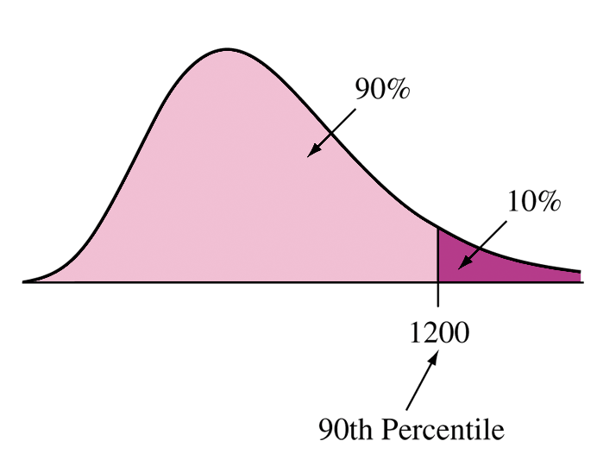
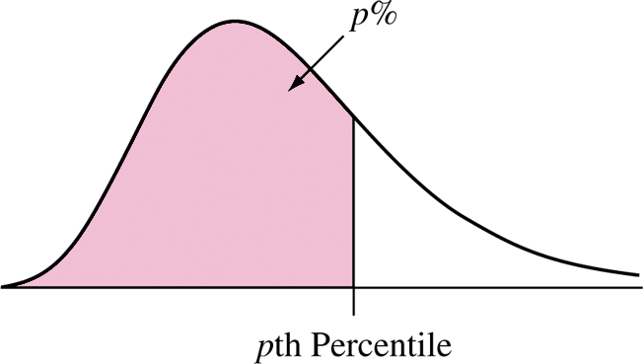
Percentile
Median = 50% percentile
The ^{th} percentile is a value such that percent of the observations fall below or at that value.

Slide 45
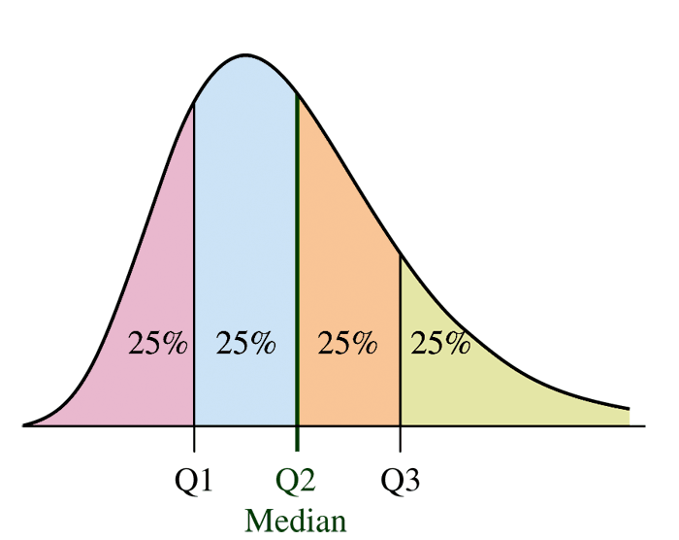
Quartiles
Figure 2.14 The Quartiles Split the Distribution Into Four Parts. 25% is below the first
quartile (Q1), 25% is between the first quartile and the second quartile (the median, Q2), 25%
is between the second quartile and the third quartile (Q3), and 25% is above the third quartile.
Question: Why is the second quartile also the median?

Slide 46
SUMMARY: Finding Quartiles
Arrange the data in order.
Consider the median. This is the second quartile, Q2.
Consider the lower half of the observations (excluding the median itself if n is odd). The median of these observations is the first quartile, Q1.
Consider the upper half of the observations (excluding the median itself if n is odd). Their median is the third quartile, Q3.

Slide 47
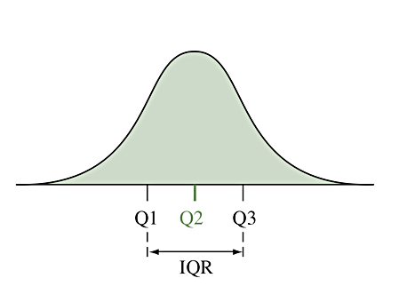
The Interquartile Range (IQR)
The interquartile range is the distance between the third quartile and first quartile:
IQR = Q3 − Q1
IQR gives the spread of middle 50% of the data.
In Words: If the interquartile range of U.S. music teacher salaries equals $16,000, this means that for the middle 50% of the distribution stretches over a distance of $16,000.

Slide 48
Detecting Potential Outliers
Examining the data for unusual observations, such as outliers, is important in any statistical analysis. Is there a formula for flagging an observation as potentially being an outlier?
The 1.5 x IQR Criterion for Identifying Potential Outliers
An observation is a potential outlier if it falls a distance of more than 1.5 x IQR below the first quartile or a distance of more than 1.5 x IQR above the third quartile.

Slide 49
Five-Number Summary of Positions
The five-number summary is the basis of a graphical display called the box plot, and consists of
  Minimum value
  First Quartile
  Median
  Third Quartile
  Maximum value

Slide 50
SUMMARY: Constructing a Box Plot
A box goes from Q1 to Q3.
A line is drawn inside the box at the median.
A line goes from the lower end of the box to the
smallest observation that is not a potential outlier and
from the upper end of the box to the largest
observation that is not a potential outlier.
The potential outliers are shown separately.

Slide 51
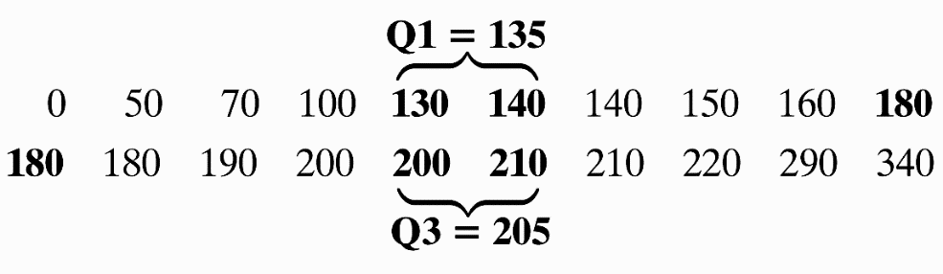
Example: Cereal Sodium Data
Consider the sodium values for the 20 breakfast cereals. What are the quartiles for the 20 cereal sodium values? From Table 2.3, the sodium values, in ascending order, are:
The median of the 20 values is the average of the 10th and 11th observations, 180 and 180, which is Q2 = 180 mg.
The first quartile Q1 is the median of the 10 smallest observations (in the top row), which is the average of 130 and 140, Q1 = 135 mg.
The third quartile Q3 is the median of the 10 largest observations (in the bottom row), which is the average of 200 and 210, Q3 = 205 mg.
1.5*IQR = 1.5*(Q3-Q1) = 1.5*(205-135) = 1.5*70 = 105
For the lower end, 135 – 1.5*IQR = 135 – 105 = 30, if x < 30, x is an outlier
For the upper end, 205 + 1.5*IQR = 205 + 105 = 310, if x > 310, outlier

Slide 52
Example: Cereal Sodium Data
Consider the sodium values for the 20 breakfast cereals. What are the quartiles for the 20 cereal sodium values? From Table 2.3, the sodium values, in ascending order, are:
1.5*IQR = 1.5*(Q3-Q1) = 1.5*(205-135) = 1.5*70 = 105
For the lower end, 135 – 1.5*IQR = 135 – 105 = 30, if x < 30, x is an outlier
For the upper end, 205 + 1.5*IQR = 205 + 105 = 310, if x > 310, outlier

Slide 53
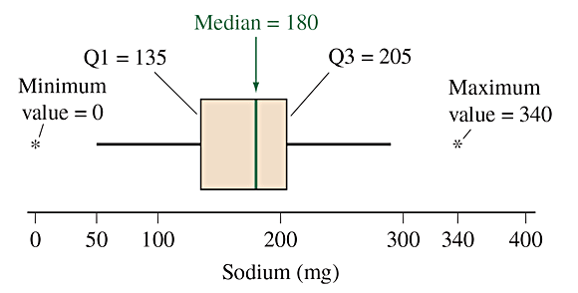
Example: Box Plot for Cereal Sodium Data
Figure 2.15 shows a box plot for the sodium values. Labels are also given for the five-number summary of positions.
Figure 2.15 Box Plot and Five-Number Summary for 20 Breakfast Cereal Sodium Values. The central box contains the middle 50% of the data. The line in the box marks the median. Whiskers extend from the box to the smallest and largest observations, which are not identified as potential outliers. Potential outliers are marked separately. Question: Why is the left whisker drawn down only to 50 rather than to 0?

Slide 54
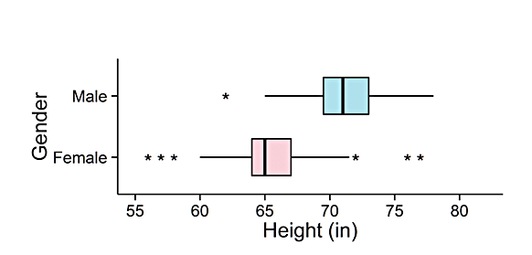
Side-by-Side Box Plots Help to Compare Groups
A box plot does not portray certain features of a distribution, such as distinct mounds and possible gaps, as clearly as does a histogram.
Box plots are useful for identifying potential outliers.
Figure 2.16 Box Plots of Male and Female College Student Heights. The box plots use the same scale for height. Question: What are approximate values of the quartiles for the two groups?

Slide 55
Z-Score
The z-score also identifies position and potential outliers.
The z-score for an observation is the number of standard deviations that it falls from the mean. A positive z-score indicates the observation is above the mean. A negative z-score indicates the observation is below the mean. For sample data, the z -score is calculated as:
An observation from a bell-shaped distribution is a potential outlier if its z-score < -3 or > +3 (3 standard deviation criterion).

Slide 56
Summary: Guidelines for Constructing Effective Graphs
Label both axes and provide proper headings.
To better compare relative size, the vertical axis should start
at 0.
Be cautious in using anything other than bars, lines, or points.
It can be difficult to portray more than one group on a single
graph when the variable values differ greatly. Consider
instead using separate graphs, or plotting relative sizes such
as ratios or percentages.

Slide 57
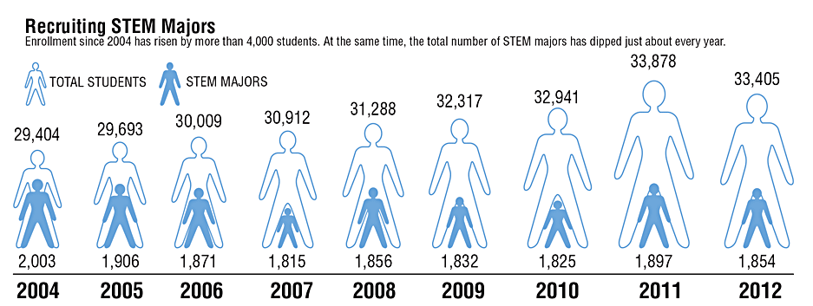
Example: Beware of Poor Graphs
Figure 2.18 An Example of a Poor Graph. Question: What’s misleading about the
way the data are presented?

Slide 58
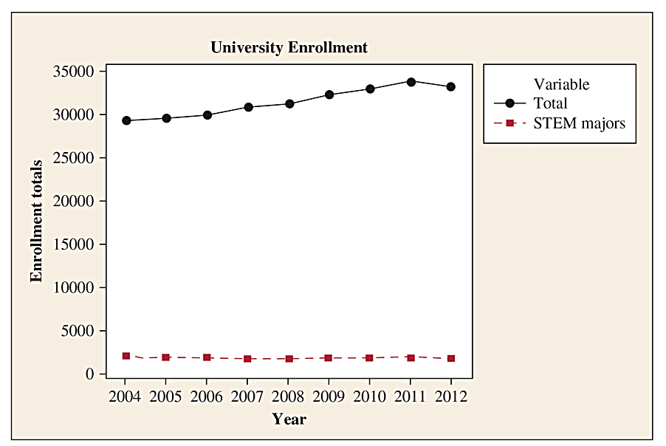
Example: Beware of Poor Graphs
Figure 2.19 A Better Graph for the Data in Figure 2.18. Question: What trends do you see in the enrollments from 2004 to 2012?

Slide 59
Probability Distributions

Slide 60
Randomness
A random variable is a numerical measurement of the outcome of a random phenomenon.
Often, the randomness results from
  the use of random sampling
  or
  a randomized experiment to gather the data.
Notes:
60

Slide 61
Random Variable
Use letters near the end of the alphabet, such as x, to symbolize:
  variables
  a particular value of the random variable.
Use a capital letter, such as X, to refer to the random variable itself.
Example: Flip a coin three times.
  X = number of heads in the 3 flips; denotes the random variable.
  x = 2; represents a possible value of the random variable.
Notes:
61

Slide 62
Probability Distribution
The probability distribution of a random variable specifies its possible values and their probabilities.
An advantage of a variable being a random variable is that it’s possible to specify such probabilities. Without randomness, we would not be able to predict the probabilities of the possible outcomes in the long run.
Notes:
62

Slide 63
Probability Distribution of a Discrete Random Variable
A discrete random variable X takes a set of separate values (such as 0, 1, 2, . . .). Its probability distribution assigns a probability P(x) to each possible value x.
For each x, the probability P(x) falls between 0 and 1.
The sum of the probabilities for all the possible x values equals 1.
Notes:
63

Slide 64
The Mean of a Discrete Probability Distribution
It is most common to use the mean to describe the center and the standard deviation to describe the variability.
Recall that numerical summaries of populations are called parameters. You can think of a population distribution as merely being a type of probability distribution— one that applies for selecting a subject at random from a population.
Notes:
64

Slide 65
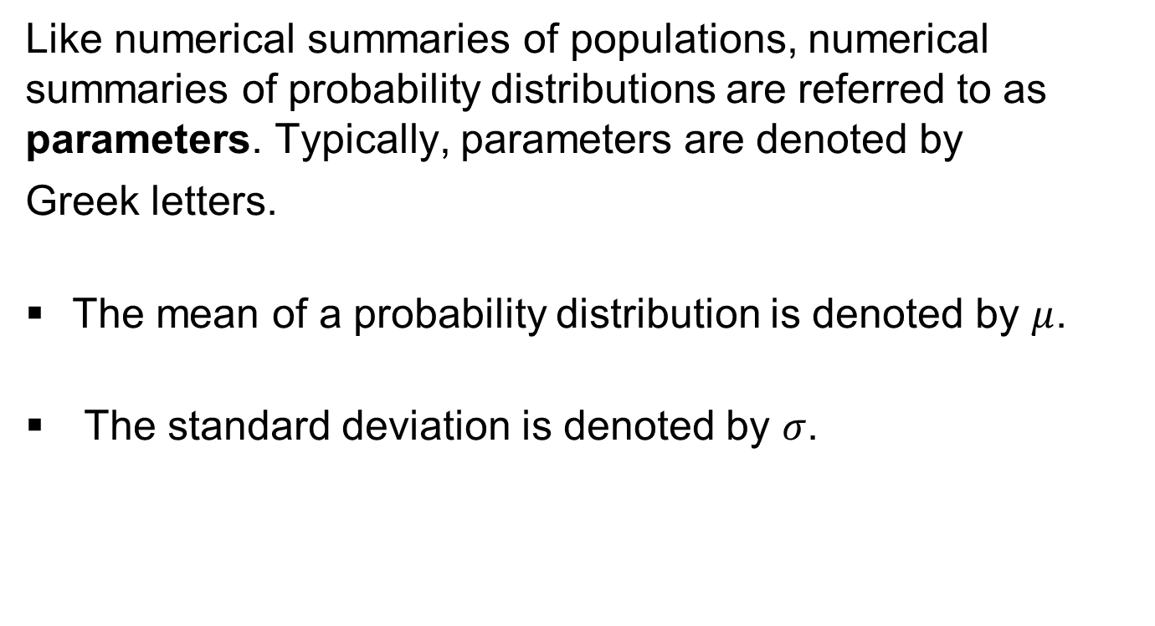
Mean of a Discrete Probability Distribution
Notes:
65

Slide 66
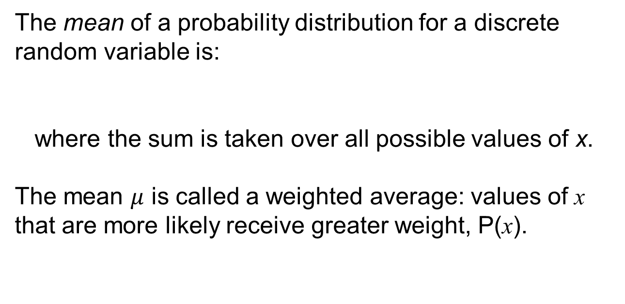
Mean of a Discrete Probability Distribution
Notes:
66

Slide 67
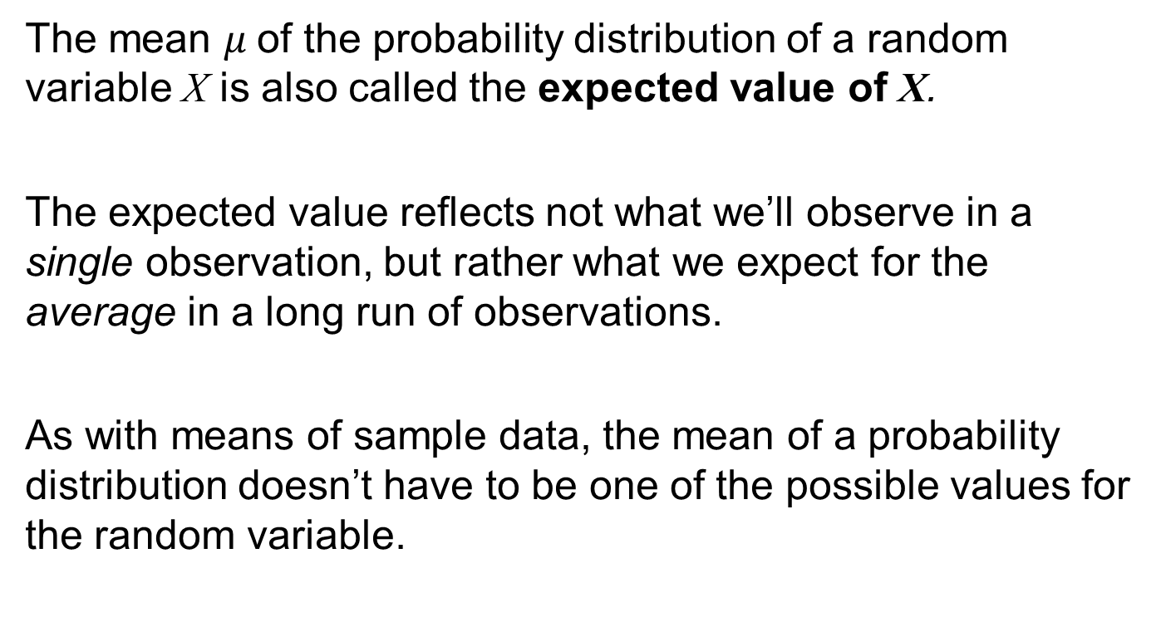
Expected Value of X
Notes:
67

Slide 68
Example: Responding to Risk
You are given $1000 to invest. You must choose between (i) a sure gain of $500, and (ii) a 0.50 chance of a gain of $1000 and a 0.50 chance to gain nothing. What is the expected gain with each strategy?
Notes:
68

Slide 69
Example: Responding to Risk
You are given $1000 to invest. You must choose between
(i) a sure gain of $500, and (ii) a 0.50 chance of a gain of $1000 and a 0.50 chance to gain nothing. What is the expected gain with each strategy?
The expected gain is $500 with the sure strategy (i), since that strategy has gain $500 with probability 1.0.
Notes:
69

Slide 70
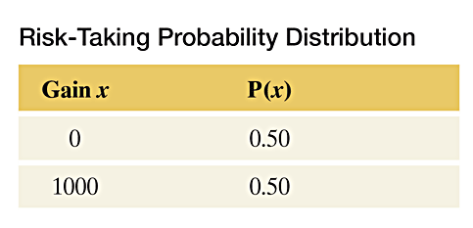
Example: Responding to Risk
You are given $1000 to invest. You must choose between (i) a sure gain of $500, and (ii) a 0.50 chance of a gain of $1000 and a 0.50 chance to gain $0. What is the expected gain with each strategy?
With the risk-taking strategy (ii),
the probability distribution is shown.
The expected gain is
Notes:
70

Slide 71
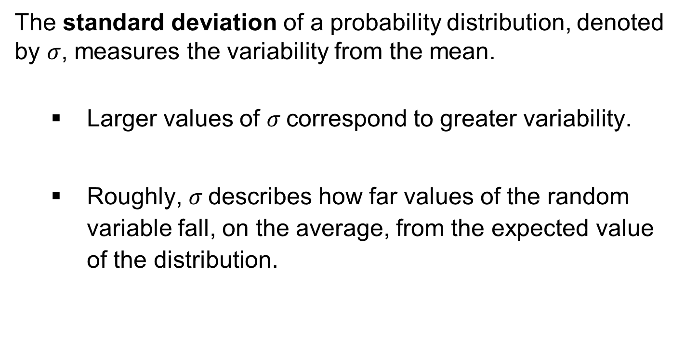
Summarizing the Variability of a Probability Distribution
Notes:
71

Slide 72
Continuous Random Variable
A random variable is called continuous when its possible values form an interval.
Examples are: time, age, and size measures such as height and weight.
Continuous variables are usually measured in a discrete manner because of rounding.
Notes:
72

Slide 73
Probability Distribution of a Continuous Random Variable
A continuous random variable has possible values that form an interval. Its probability distribution is specified by a curve that determines the probability that the random variable falls in any particular interval of values.
  Each interval has probability between 0 and 1.
  The interval containing all possible values has probability equal to 1.
Notes:
73

Slide 74
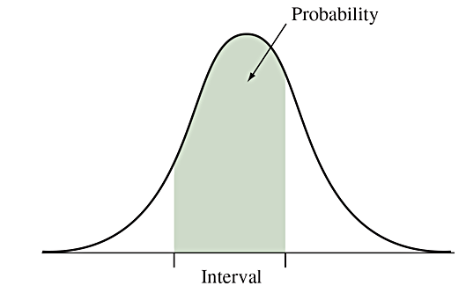
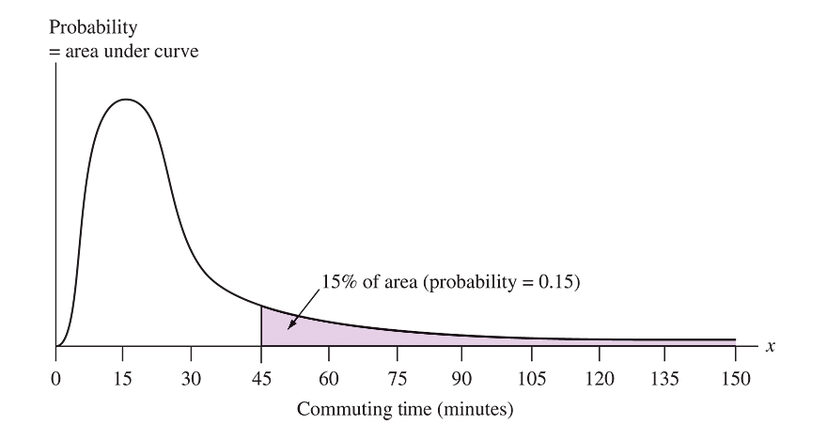
Probability Distribution of a Continuous Random Variable
The probability for the interval is given by the area under the curve, above that interval.
Smooth curve approximation
Figure 6.2 Probability Distribution of Commuting Time. The area under the curve for values higher than 45 is 0.15. Question: Identify the area under the curve represented by the probability that commuting time is less than 15 minutes, which equals 0.29.
Notes:
74

Slide 75
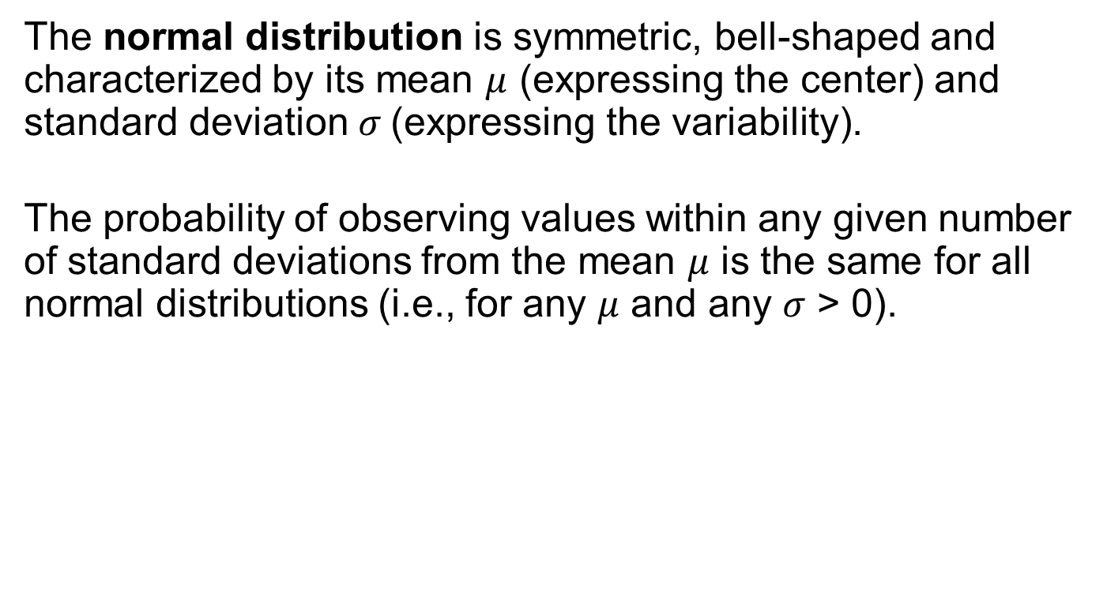
The Normal Distribution

Slide 76
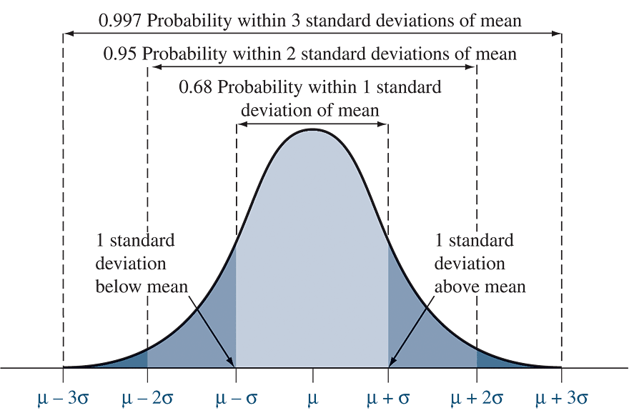
The Normal Distribution: A Probability Distribution with a Bell-Shaped Curve
Figure 6.5 The Normal Distribution. The probability equals 0.68 for the interval within 1 standard deviation of the mean, 0.95 for the interval within 2 standard deviations, and 0.997 for the interval within 3 standard deviations. Question How do these probabilities relate to the empirical rule?

Slide 77
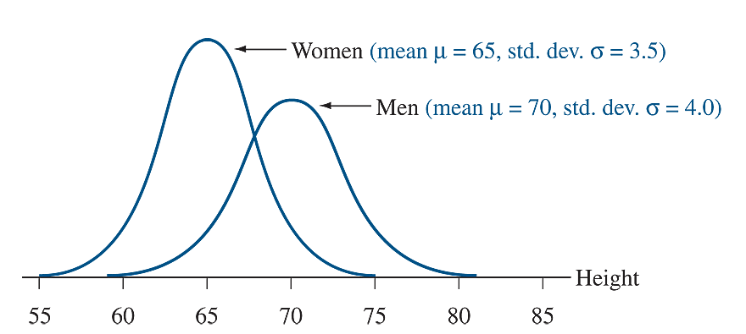
Example : 68-95-99.7% Rule
Within what interval do almost (95%) all of the women’s heights fall? 65 – 2*3.5 = 58 < women < 65 + 2*3.5 = 72
Figure 6.4 Normal Distributions for Women’s Height and Men’s Height. For each different combination of and values, there is a normal distribution with mean and standard deviation . Question: Given that = 70 and = 4, within what interval do almost all of the men’s heights fall?

Slide 78
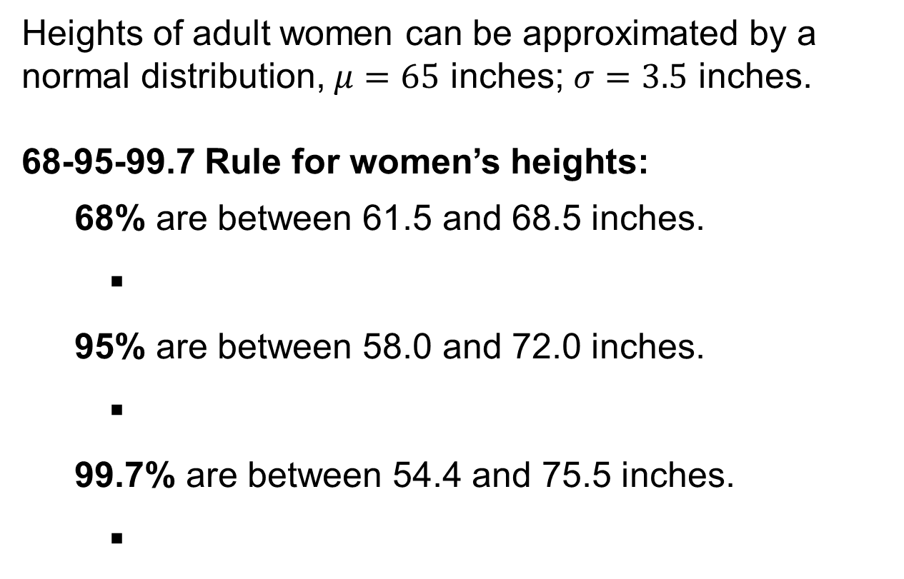
Example : 68-95-99.7% Rule
Notes:
78

Slide 79
The Normal Distribution
    The normal distribution is the most important distribution in statistics.
    Many distributions have an approximately normal distribution.
    The normal distribution approximates many discrete distributions well when there are a large number of possible outcomes.
    Many statistical methods use it even when the data are not bell-shaped.

Slide 80
Normal Probabilities and the Empirical Rule
The empirical rule states that for an approximately bell-shaped distribution, about 68% of observations fall within 1 standard deviation of the mean, 95% within 2 standard deviations, and nearly all within 3. In fact, those percentages came from probabilities calculated for the normal distribution.
The empirical rule stated the probabilities as being approximate rather than exact because that rule referred to all approximately bell-shaped distributions, not just the normal.
Notes:
80

Slide 81
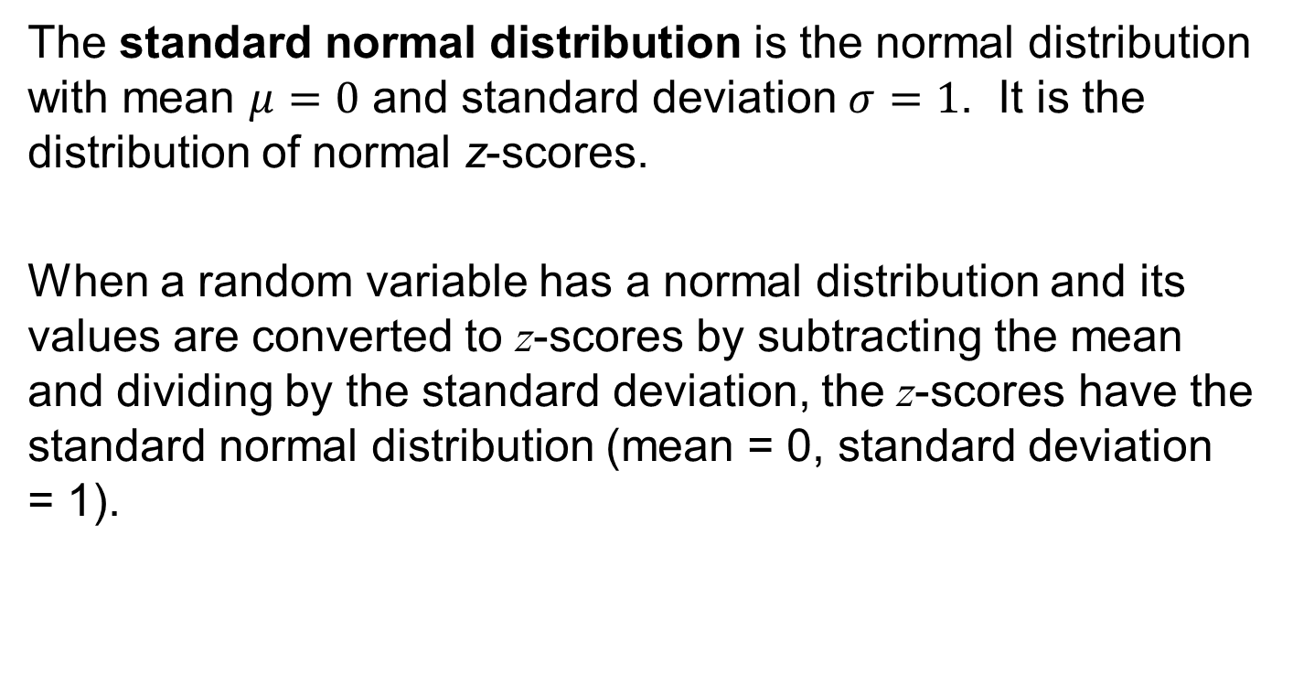
Z-Scores and the Standard Normal Distribution

Slide 82
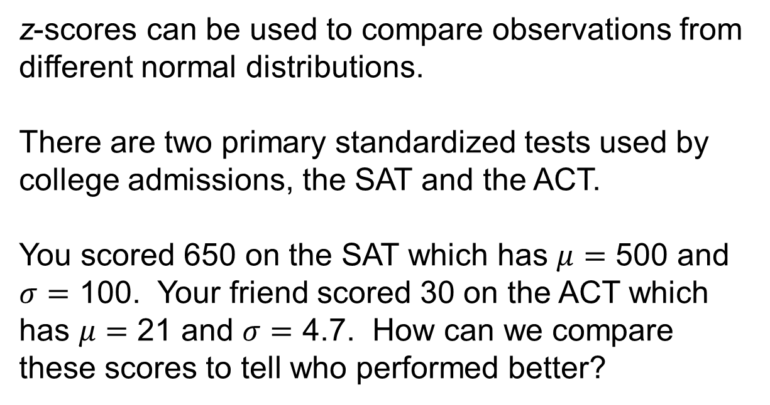
Example: Comparing Test Scores That Use Different Scales

Slide 83
Example: Comparing Test Scores That Use Different Scales
Using Z-scores to Compare Distributions
  Compare z-scores:
  SAT: ACT:
The ACT score of 30 is a bit higher than the SAT score of 650, since ACT = 30 falls 1.91 standard deviations above its mean, whereas SAT = 650 falls 1.50 standard deviations above its mean.
In this sense, the ACT score is better even though its numerical value is smaller.

Slide 84
The Binomial Distribution: Probabilities for Counts with Binary Data
We use the binomial distribution when each observation is binary: it has one of two possible outcomes.
Examples:
  Accept or decline an offer from a bank for a credit card.
  Have or do not have health insurance.
  Vote yes or no on a referendum.
Notes:
84

Slide 85
Conditions for the Binomial Distribution
  Each of n trials has two possible outcomes: “success” or “failure”.
  Each trial has the same probability of success, denoted by p, so the probability of a failure is denoted by .
  The n trials are independent. That is, the result for one trial does not depend on the results of other trials.
The binomial random variable X is the number of successes in the n trials.
Notes:
85

Slide 86
Probabilities for a Binomial Distribution
When the number of trials n is large, it’s tedious to write out all the possible outcomes in the sample space. There is a formula you can use to find binomial probabilities for any n.
Denote the probability of success on a trial by p. For n independent trials, the probability of x successes equals:
Notes:
86

Slide 87
Factorials
Rules for factorials:
For example,

Slide 88
Example: Testing for Gender Bias in Promotions
A group of women employees has claimed that female employees are less likely than male employees of similar qualifications to be promoted.
  Of 1000 employees, 50% are female.
  None of the 10 employees chosen for management training were female.
  The probability that no females are chosen is:
It is very unlikely (one chance in a thousand) that none of the 10 selected for management training would be female if the employees were chosen randomly.
Notes:
88

Slide 89
Check to See If Binomial Conditions Apply
Before using the binomial distribution, check that its three conditions apply:
  Binary data (success or failure)
  The same probability of success for each trial (denoted by p)
  Independent trials
Notes:
89

Slide 90
Example: Testing for Gender Bias in Promotions
Do the Binomial Conditions Apply?
The data are binary (male, female).
If employees are selected randomly, the probability of
selecting a female on any given trial is 0.50.
With random sampling of 10 employees from a large
population, the outcome for one trial doesn’t depend on
the outcome of another trial.
Notes:
90

Slide 91
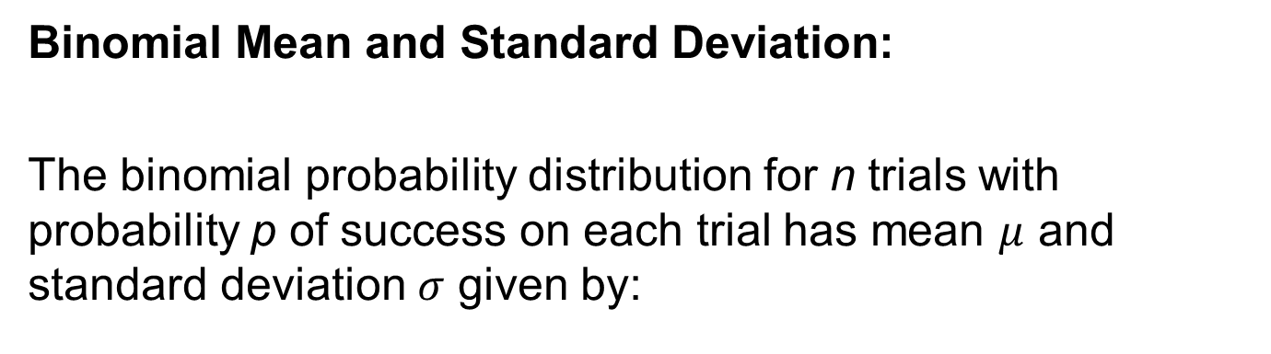
Mean and Standard Deviation of the Binomial Distribution
Notes:
91

Slide 92
Example: Checking for Racial Profiling
In 2006, the New York City Police Department (NYPD) confronted approximately 500,000 pedestrians for suspected criminal violations.
  88.9% were non-white.
  Meanwhile, according to the 2006 American Community Survey conducted by the U.S. Census Bureau, of the more than 8 million individuals living in New York City, 44.6% were white.
  55.4% non-white
Are the data presented above evidence of racial profiling in police officers’ decisions to confront particular individuals?
Notes:
92

Slide 93
Example: Checking for Racial Profiling
Assume:
  500,000 confrontations as n = 500,000 trials.
  p(driver is non-white) is p = 0.554.
Calculate the mean and standard deviation of this binomial distribution:
Notes:
93

Slide 94
Example: Checking for Racial Profiling
Recall: Empirical Rule
  When a distribution is bell-shaped, close to 100% of the observations fall within 3 standard deviations of the mean:
If no racial profiling is taking place, we would not be surprised if between about 275,947 and 278,053 of the 500,000 people stopped were non-white. However, 88.9% of all stops, or 500,000(0.889) = 444,500, involved non-whites. This suggests that the number of non-whites stopped is much higher than we would expect if the probability of confronting a pedestrian were the same for each resident, regardless of their race.
Notes:
94

Slide 95
Sampling Distributions

Slide 96
Example: Predicting Election Results Using Exit Polls
How do we know if the sample proportion from the California exit poll is a good estimate, falling close to the population proportion?
The total number of voters was over nine million, and the poll sampled a minuscule portion of them.
This section introduces a type of probability distribution called the sampling distribution that helps us determine how close to the population parameter a sample statistic is likely to fall.
Notes:
96

Slide 97
Example: Predicting Election Results Using Exit Polls
Using exit polls, polling organizations predict winners after learning how a small number of people voted, often only a few thousand out of possibly millions of voters.
After sampling 3889 randomly selected voters,
53.1% said they voted for Brown, 42.4% for Whitman and 4.5% for other/no answer.
At the time of the exit poll, the percentage of the entire voting population (nearly 9.5 million people) that voted for Brown was unknown.
Notes:
97

Slide 98
Example: Predicting Election Results Using Exit Polls
How close can we expect a sample percentage to be to the population percentage?
How does the sample size influence our analyses?
The sampling distribution helps us determine how close to the population parameter a sample statistic is likely to fall.
Notes:
98

Slide 99
Example: Predicting Election Results Using Exit Polls
Let X = vote outcome, with x = 1 for Jerry Brown and x = 0 for all other responses.
The possible values of the random variable X (0 and 1) and the proportion of times these values occurred (0.469 and 0.531) give the data distribution for this one sample.
Final results showed that Brown officially received a proportion of 0.538 of the votes. So, for the population of voters on election day, the possible values of the random variable X (0 and 1) and the proportion of times these values occurred (0.462 and 0.538) form the population distribution.
Notes:
99

Slide 100
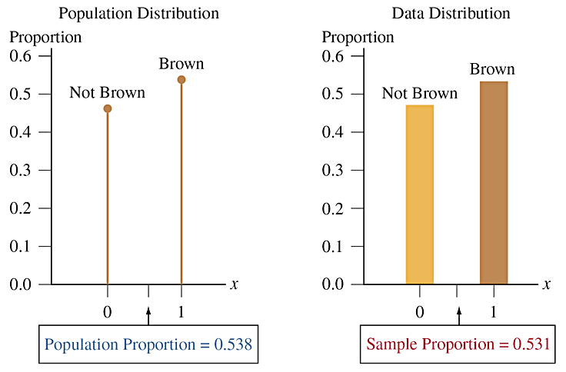
Example: Predicting Election Results Using Exit Polls
Figure 7.1 The population (9.5 million voters) and data (n=3889) Distributions of
Candidate Preference (0 = Not Brown, 1= Brown). Question Why do these look so similar?
Notes:
100

Slide 101
Sampling Distribution
The sampling distribution of a statistic is the probability distribution that specifies probabilities for the possible values the statistic can take.
A sampling distribution is merely a type of probability distribution. Rather than giving probabilities for the outcome of the vote of an individual subject (as in a
population distribution), it gives probabilities for the value of a statistic computed from a sample.
Notes:
101

Slide 102
A Sampling Distribution Informs How Close a Statistic Falls to a Parameter
Sampling distributions describe the variability in a sample statistic that occurs from sample to sample (or study to study).
Sampling distributions help us to predict how close a statistic falls to the parameter it estimates.
Every sample statistic is a random variable and, hence, has a sampling distribution. Besides the sample proportion, there is a sampling distribution of a sample
mean, a sampling distribution of a sample median, a sampling distribution of a sample standard deviation, and so forth.
Notes:
102

Slide 103
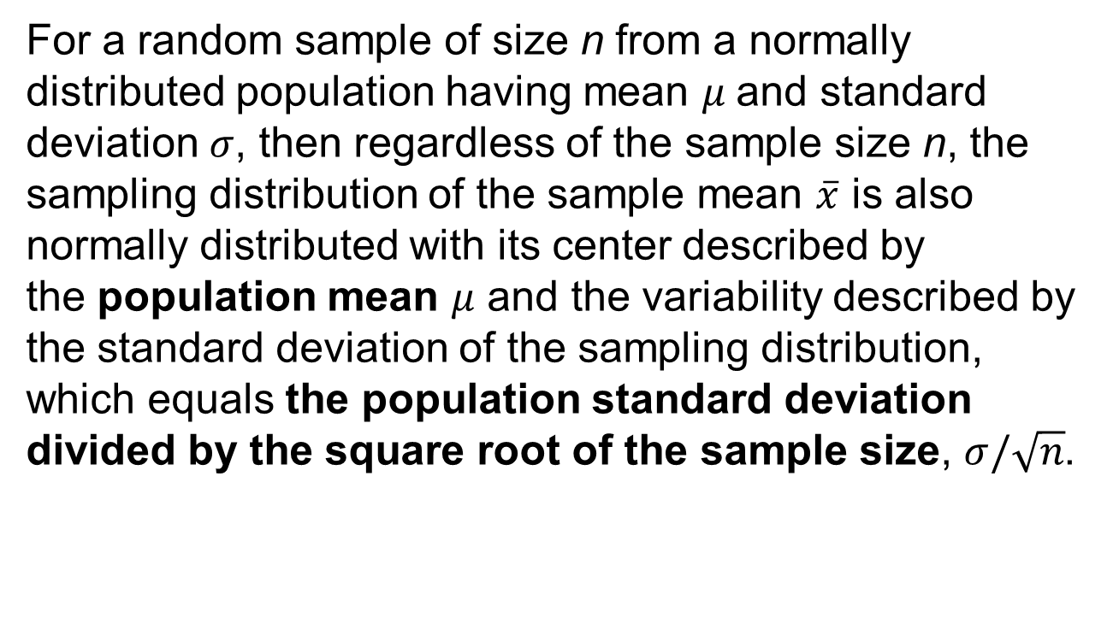
SUMMARY: The Sampling Distribution of the Sample Mean When the Population Distribution is Normally Distributed
Notes:
103

Slide 104
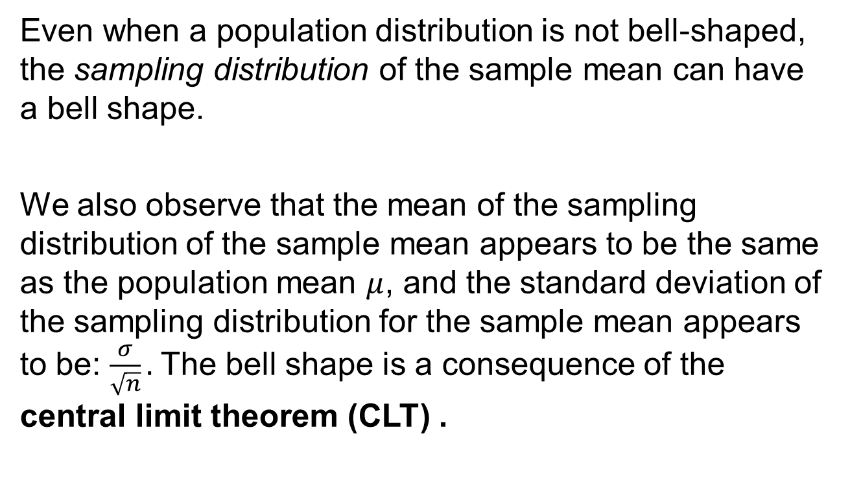
Describing the Behavior of the Sampling Distribution for the Sample Mean for any Population
Notes:
104

Slide 105
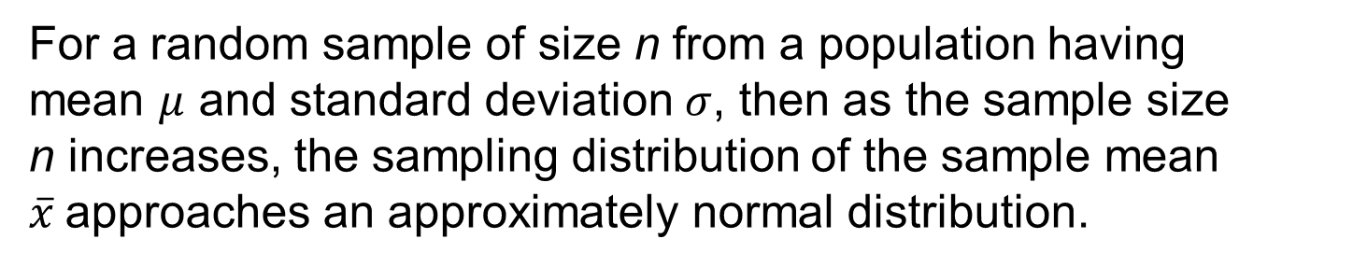
The Central Limit Theorem (CLT): Describes the Expected Shape of the Sampling Distribution for Sample Mean
Notes:
105

Slide 106
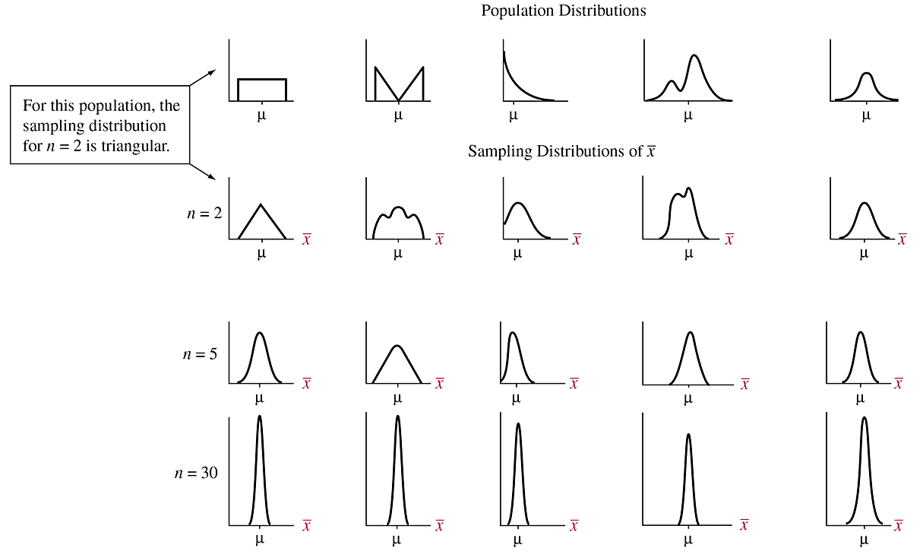
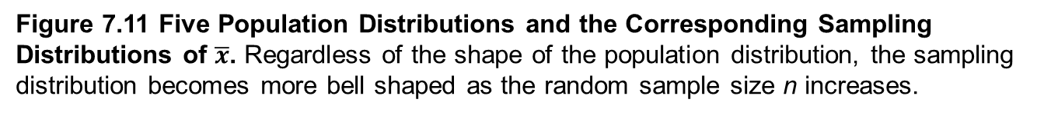
Population Distribution
Notes:
106

Slide 107
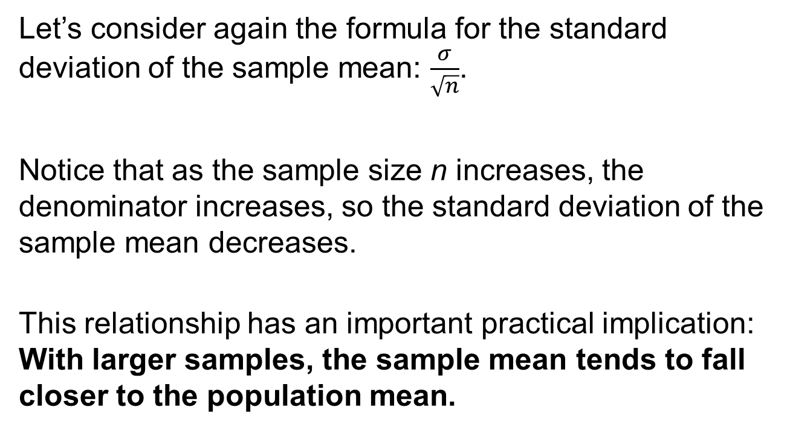
Effect of n on the Standard Deviation of the Sampling Distribution
Notes:
107

Slide 108
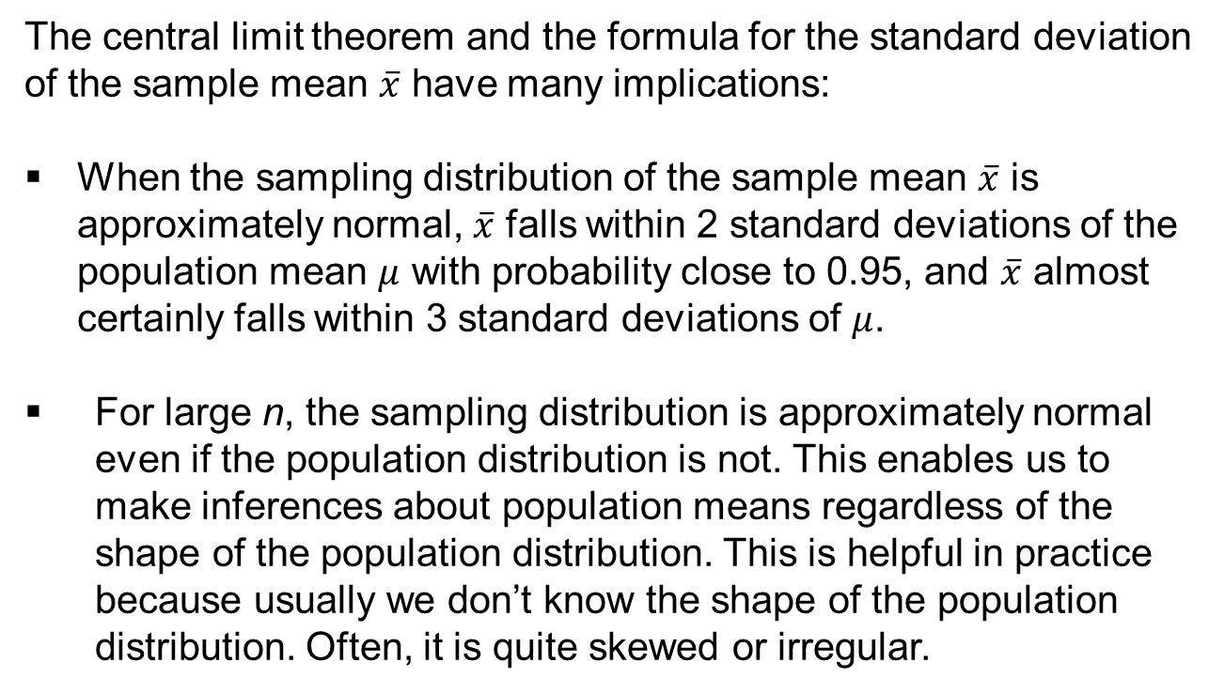
The Central Limit Theorem Helps Us Make Inferences
Notes:
108

Slide 109
The Bootstrap: Using Simulation to Construct a Confidence Interval
When it is difficult to derive a standard error or a confidence interval formula that works well, you can “pull yourself up by your bootstraps” to attack the problem without using mathematical formulas.
The bootstrap is a simulation method that resamples from the observed data. It treats the data distribution as if it were the population distribution.
Notes:
109

Slide 110
The Bootstrap: Using Simulation to Construct a Confidence Interval
To use the bootstrap method:
    You resample, with replacement, n observations from the data distribution.
    For the new sample of size n, construct the point estimate of the parameter of interest.
    Repeat the process a very large number of times (e.g., selecting 10,000 separate samples of size n and calculating the 10,000 corresponding parameter estimates).
Notes:
110

Slide 111
Example: How Variable Are Your Weight Readings on a Scale?
To investigate how much the weight readings tend to vary, one of the authors weighed himself ten times, taking a 30-second break after each trial to allow the scale to reset.
He got the following values (in pounds):
160.2, 160.8, 161.4, 162.0, 160.8
162.0, 162.0, 161.8, 161.6, 161.8.
These 10 trials have a mean of 161.44 and standard deviation of 0.63.
Using the bootstrap method, find a 95% confidence interval for the population standard deviation. (Web APP)
Notes:
111

